Slide 1

Unit-05 Data Wrangling
Python for Data Science (PDS) (3150713)
Prof. Arjun V. Bala
Computer Engineering Department
arjun.bala@darshan.ac.in
9624822202

Slide 2

Outline
Classes in Scikit-learn library
Applications of Data Science
Hashing Trick
Deterministic Selection
Considering Timing and Performance
Parallel Processing
The EDA Approach
Understanding Correlation
Modifying Data Distributions
Looping

Slide 3
Classes in Scikit-learn
Understanding how classes work is an important prerequisite for being able to use the Scikit-learn package appropriately.
Scikit-learn is the package for machine learning and data science experimentation favored by most data scientists.
It contains wide range of well-established learning algorithms, error functions and testing procedures.
Install : conda install scikit-learn
There are four class types covering all the basic machine-learning functionalities,
Classifying
Regressing
Grouping by clusters
Transforming data
Even though each base class has specific methods and attributes, the core functionalities for data processing and machine learning are guaranteed by one or more series of methods and attributes.

Slide 4
Choosing a correct algorithm in Scikit-learn
Get more data
>50
samples
Start
Predicting a category?
Predicting a Quantity?
No
Yes
Not working
Do you have Labeled data?
Clustering
Regression
<100K
samples
<100K
samples
no. of category known
Randomized
PCA
No Algo
SGD
Regressor
Few features are important
Linear SVC
SGD
Classifier
<10K
samples
<10K
samples
<10K
samples
Text data?
KMeans
RidgeRegressor
kernel
approximation
Mini Batch
KMeans
Lasso
Kernel
approximation
Isomap
SVR(kernel=‘linear’)
Spectral
Embedding
ElasticNet
Spectral
Clustering
Mean Shift
Dimensionality
Reduction
Naïve
Bayes
Kneighbors
Classifier
SVC
EnsembleRegressor
Ensemble
Classifiers
GMM
VBGMM
Classification
SVR(kernel=‘rbf’)
LLE

Slide 5
Supervised V/S Unsupervised Learning
Supervised Learning | Unsupervised Learning
Supervised learning algorithms are trained using labeled data. | Unsupervised learning algorithms are trained using unlabeled data.
Supervised learning model takes direct feedback to check if it is predicting correct output or not. | Unsupervised learning model does not take any feedback.
The goal of supervised learning is to train the model so that it can predict the output when it is given new data. | The goal of unsupervised learning is to find the hidden patterns and useful insights from the unknown dataset.
Supervised learning can be categorized in Classification and Regression problems. | Unsupervised Learning can be classified in Clustering and Associations problems.
Supervised learning model produces an accurate result. | Unsupervised learning model may give less accurate result as compared to supervised learning.
It includes various algorithms such as Linear Regression, Logistic Regression, Support Vector Machine, Multi-class Classification, Decision tree, Bayesian Logic, etc. | It includes various algorithms such as Clustering, KNN, and Apriori algorithm.

Slide 6
Machine Learning Process for Supervised Learning
Test Data
Model Testing
Collecting data
Cleaning data
Splitting data
Update Parameters
Model Deployment
Train Data
Model Training

Slide 7
Basic Structure of Scikit-Learn
Step – 01 (import)
Step – 02 (create object)
from sklearn.family import Model
Example
from sklearn.linear_model import LinearRegression
m = Model(parameters)
Example
lr = LinearRegression()
Step – 03 (split data) (Only For Supervised Learning)
from sklearn.model_selection import train_test_split
X_train, X_test, y_train, y_test = train_test_split(X,y,test_size=0.3)
Step – 04 (Train Model)
Step – 06 (Evaluate Model)
m.fit(X_train,y_train) #For Supervised Learning
OR
m.fit(X_train) #For Unsupervised Learning
Evaluate the model and update the parameters if required.
Evaluating technique will be different for regression, classification and clustering.
We will explore all the techniques in later sessions.
Example Model Evaluation for Regression
from sklearn import metrics
print(metrics_mean_squared_error(ytest,predictions))
Step – 05 (Predict) (Only For Supervised Learning)
predictions = m.predict(X_train)

Slide 8
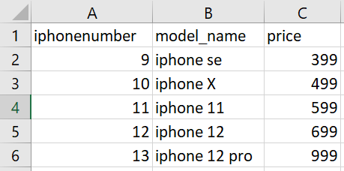
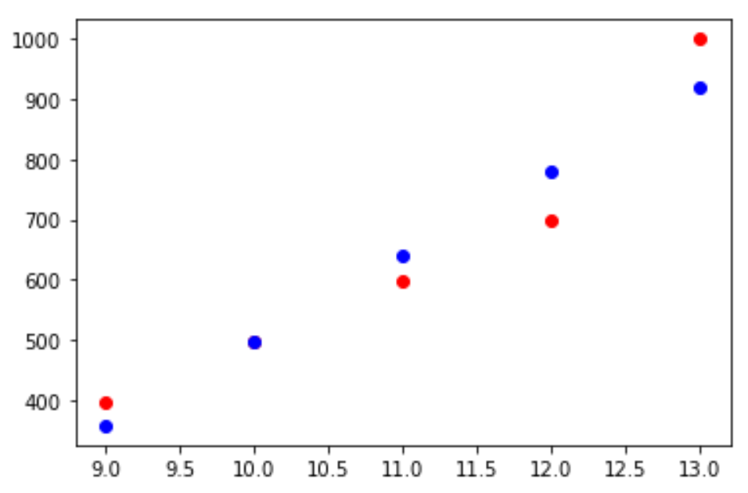
Linear Regression (Example) (iPhone Prices)
iPhoneLinReg.py
1
2
3
4
5
6
7
8
9
10
11
12
13
14
15
16
17
18
19
import pandas as pd
df = pd.read_csv('iphones.csv')
from sklearn.linear_model import LinearRegression
lr = LinearRegression()
X = df['iphonenumber'].values.reshape(-1,1)
y = df['price']
lr.fit(X,y)
lr.predict([[14]]) # price for the next iphone
predicted = lr.predict(X)
import matplotlib.pyplot as plt
%matplotlib inline
plt.scatter(df['iphonenumber'],df['price'],c='r')
plt.scatter(df['iphonenumber'],predicted,c='b')
iphones.csv
Output

Slide 9
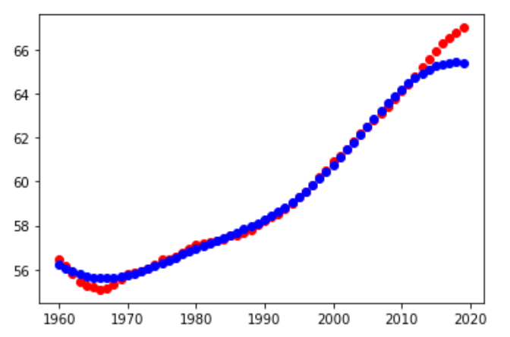
Support Vector Regression (SVR) (Example)
iPhoneLinReg.py
1
2
3
4
5
6
7
8
9
10
11
12
13
14
15
16
17
18
19
import pandas as pd
df = pd.read_csv('WorldBank.csv')
pop15 = df[df['Indicator Name']=='Population ages 15-64 (% of total population)']
X = np.arange(1960,2020)
y = pop15.values[0][4:-1]
from sklearn.svm import SVR
model = SVR()
model.fit(X.reshape(-1,1),y)
predictPoly = model.predict(X.reshape(-1,1))
import matplotlib.pyplot as plt
%matplotlib inline
plt.scatter(X,y,c='r')
plt.scatter(X,predictPoly,c='b')
WorldBank.csv
Download link
Output

Slide 10
Bag of Words Model (Topic from Unit-03)
Before we can perform analysis on textual data, we must tokenize every word within the dataset.
The act of tokenizing the words creates a bag of words.
The creation of a bag of words revolves around Natural Language Processing (NLP).
Before we can do NLP we should perform below specified processes
Remove special characters
Such as html tags and special characters
Remove the stop words
Some of the English stop words are a, an, the, are, at, this, is etc….
Stemming words
Stemming the words means removing suffix and prefix of the word
Example :
Play
Playing
Plays
Played
Play

Slide 11
Hashing Trick
Most Machine Learning algorithms uses numeric inputs, if our data contains text instead we need to convert those text into numeric values first, this can be done using hashing tricks.
For Example our dataset is something like below table,
We can not apply the machine learning algorithms in text like Male/Female, we need numeric values instead of this, One thing which we can do here is assigning the number to each word and replace that number with the word.
If we assign 1 to male and 0 to female we can use ML algorithms, same data set in numeric values are given above.
Id | Salary | Gender
1 | 10000 | Male
2 | 15000 | Female
3 | 12000 | Male
4 | 11000 | Female
5 | 20000 | Male
Id | Salary | Gender | Gender_Numeric
1 | 10000 | Male | 1
2 | 15000 | Female | 0
3 | 12000 | Male | 1
4 | 11000 | Female | 0
5 | 20000 | Male | 1

Slide 12
Hashing Trick (Cont.)
In machine learning, feature hashing, also known as the hashing trick, is a fast and space-efficient way of vectorising features, i.e. turning arbitrary features into indices in a vector or matrix.
When dealing with text, one of the most useful solutions provided by the Scikit‐learn package is the hashing trick.
Example :
Input
Numeric Representation
darshan is the best engineering college in rajkot
rajkot is famous for engineering
college is located in rajkot morbi road
1 2 3 4 5 6 7 8
8 2 9 10 5
6 2 11 7 8 12 13
1
2
3
4
5
6
7
8
9
10
11
12
13
darshan
is
the
best
engineering
college
in
rajkot
famous
for
located
morbi
road
1 1 1 1 1 1 1 1 0 0 0 0 0
0 1 0 0 1 0 0 1 1 1 0 0 0
0 1 0 0 0 1 1 1 0 0 1 1 1

Slide 13
Implementing Hashing Trick
hashTrick.py
Output
1
2
3
4
5
6
7
8
9
10
11
12
13
14
a = ["darshan is the best engineering college in rajkot","rajkot is famous for engineering","college is located in rajkot morbi road"]
from sklearn.feature_extraction.text import *
countVector = CountVectorizer()
X_train_counts = countVector.fit_transform(a)
print(countVector.vocabulary_)
print(X_train_counts.toarray())
{'darshan': 2,
'is': 7,
'the': 12,
'best': 0,
'engineering': 3,
'college': 1,
'in': 6,
'rajkot': 10,
'famous': 4,
'for': 5,
'located': 8,
'morbi': 9,
'road': 11}
array([[1, 1, 1, 1, 0, 0, 1, 1, 0, 0, 1, 0, 1],
[0, 0, 0, 1, 1, 1, 0, 1, 0, 0, 1, 0, 0],
[0, 1, 0, 0, 0, 0, 1, 1, 1, 1, 1, 1, 0]], dtype=int64)

Slide 14
CountVectorizer
CountVectorizer contains many parameters which can be very useful
while dealing with the textual data, some of the important parameters are
max_features
Build a vocabulary that only consider the top max_features ordered by term frequency across the corpus.
stop_words
Will remove the stops words, default is None, we can set to ‘english’ if we want to remove english stop words.
ngram_range
The lower and upper boundary of the range of n-values for different word n-grams or char n-grams to be extracted.
hashTrick.py
Output
1
2
3
4
5
6
7
8
9
10
from sklearn.feature_extraction.text import *
a = ["darshan is the best engineering college in rajkot","rajkot is famous for engineering","college is located in rajkot morbi road"]
cv1 = CountVectorizer(stop_words="english")
cv2 = CountVectorizer(ngram_range=(2,2))
X_train_1 = cv1.fit_transform(a)
X_train_2 = cv2.fit_transform(a)
print(cv1.vocabulary_)
print(cv2.vocabulary_)
{'darshan': 2, 'best': 0, 'engineering': 3, ……… , 'morbi': 6, 'road': 8}
{'darshan is': 3, 'is the': 10, 'the best': 15, 'best engineering': 0, ………… , 'is located': 9, 'located in': 11, 'rajkot morbi': 14, 'morbi road': 12}

Slide 15
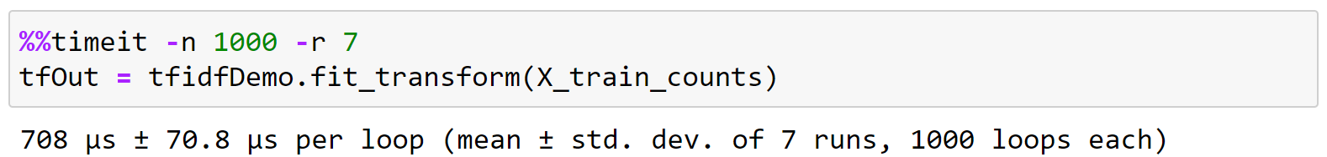
timeit (Magic Command in Jupyter Notebook)
We can find the time taken to execute a statement or a cell in a Jupyter Notebook with the help of timeit magic command.
This command can be used both as a line and cell magic:
In line mode you can time a single-line statement (though multiple ones can be chained with using semicolons).
In cell mode, the statement in the first line is used as setup code (executed but not timed) and the body of the cell is timed. The cell body has access to any variables created in the setup code.
Syntax :
Line : %timeit [-n<N> -r<R> [-t|-c] -q -p<P> -o]
Cell : %%timeit [-n<N> -r<R> [-t|-c] -q -p<P> -o]
Here, -n flag represents the number of loops and –r flag represents the number of repeats
Example :

Slide 16
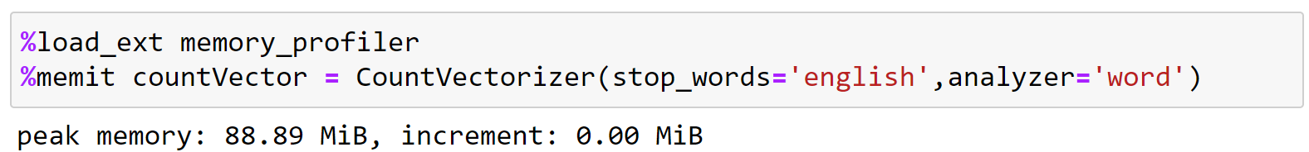
Memory Profiler
This is a python module for monitoring memory consumption of a process as well as line-by-line analysis of memory consumption for python programs.
Installation : pip install memory_profiler
Usage :
First Load the profiler by writing %load_ext memory_profiler in the notebook
Then write %memit on each statement you want to monitor memory.
Example :

Slide 17
Running in Parallel
Most computers today are multicore (two or more processors in a single package), some with multiple physical CPUs.
One of the most important limitations of Python is that it uses a single core by default. (It was created in a time when single cores were the norm.)
Data science projects require quite a lot of computations.
Part of the scientific aspect of data science relies on repeated tests and experiments on different data matrices.
Also the data size may be huge, which will take lots of processing power.
Using more CPU cores accelerates a computation by a factor that almost matches the number of cores.
For example, having four cores would mean working at best four times faster.
But practically we will not have four times faster processing as assigning the different cores to different processes will take some amount of time.
So parallel processing will works best with huge datasets or where extreme processing power is required.

Slide 18
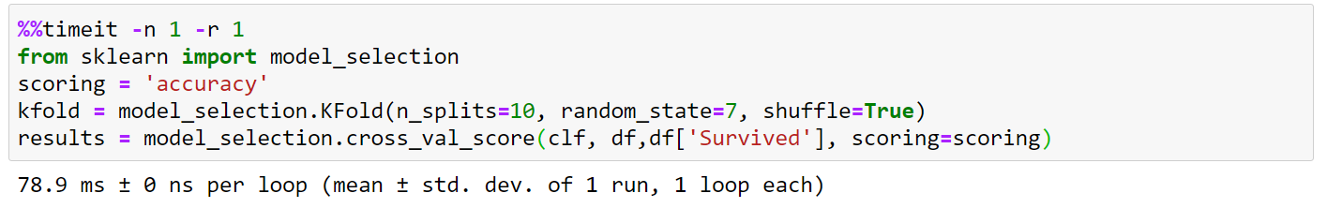
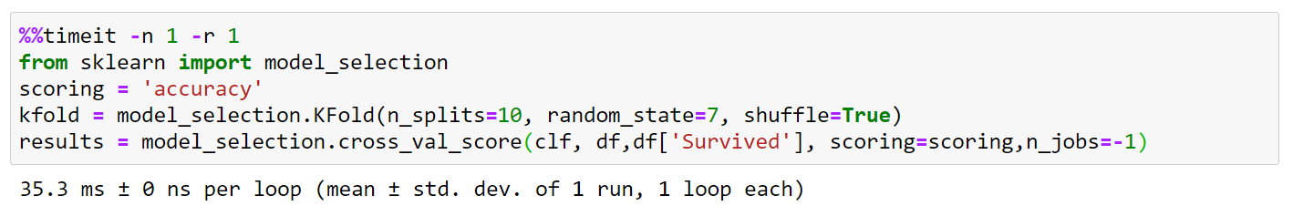
Running in Parallel (Cont.)
In Scikit-learn library we need not to do any special programming in order to do the parallel (multiprocessing) processing, we can simply use n_jobs parameter to do so.
If we set number grater than 1 in the n_jobs it will uses that much of the processor, if we set -1 to n_jobs it will use all available processor from the system.
Lets see the Example how we can achieve parallel processing in Scikit-learn liabrary.
Using Single Processor
Using Multi Processor

Slide 19
Exploratory Data Analysis (EDA)
Exploratory Data Analysis (EDA) refers to the critical process of performing initial investigations on data so as to discover patterns, to spot anomalies, to test hypothesis and to check assumptions with the help of summary statistics and graphical representations.
EDA was developed at Bell Labs by John Tukey, a mathematician and statistician who wanted to promote more questions and actions on data based on the data itself.
In one of his famous writings, Tukey said:
“The only way humans can do BETTER than computers is to take a chance of doing WORSE than them.”
Above statement explains why, as a data scientist, your role and tools aren’t limited to automatic learning algorithms but also to manual and creative exploratory tasks.
Computers are unbeatable at optimizing, but humans are strong at discovery by taking unexpected routes and trying unlikely but very effective solutions.

Slide 20
EDA (cont.)
With EDA we,
Describe data
Closely explore data distributions
Understand the relationships between variables
Notice unusual or unexpected situations
Place the data into groups
Notice unexpected patterns within the group
Take note of group differences

Slide 21
EDA - Measuring Central Tendency
We can use many inbuilt pandas functions in order to find central tendency of the numerical data, Some of the functions are
df.mean()
df.median()
df.std()
df.max()
df.min()
df.quantile(np.array([0,0.25,0.5,0.75,1]))
We can define normality of the data using below measures
Skewness defines the asymmetry of data with respect to the mean.
It will be negative if the left tail is too long.
It will be positive if the right tail is too long.
It will be zero if left and right tail are same.
Kurtosis shows whether the data distribution, especially the peak and the tails, are of the right shape.
It will be positive if distribution has marked peak.
It will be zero if distribution is flat.

Slide 22
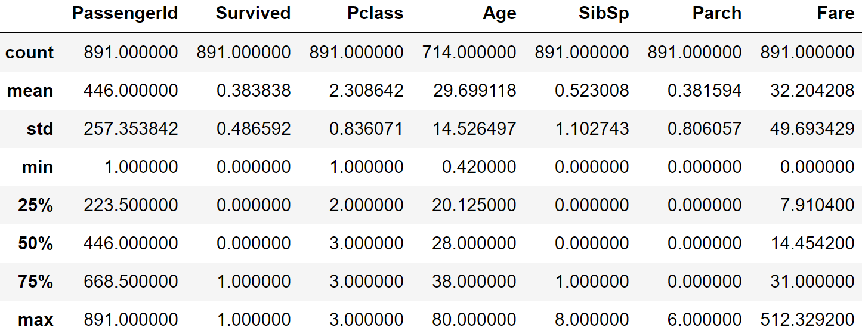
Obtaining the frequencies
We can use pandas built-in function value_counts() to obtain the frequency of the categorical variables.
We also can use another pandas built-in function describe() to obtain insights of the data.
valueCount.py
Output
1
print(df["Sex"].value_counts())
male 577
female 314
Name: Sex, dtype: int64
valueCount.py
Output
1
print(df.describe())

Slide 23
Visualization for EDA
We can use many types of graphs, some of them are listed below
if we want to show how various data elements contribute towards a whole, we should use pie chart.
If we want to compare data elements, we should use bar chart.
If we want to show distribution of elements, we should use histograms.
If we want to depict groups in elements, we should use boxplots.
If we want to find patterns in data, we should use scatterplots.
If we want to display trends over time, we should use line chart.
If we want to display geographical data, we should use basemap.
If we want to display network, we should use networkx.
In addition to all these graphs, we also can use seaborn library to plot advanced graphs like,
Countplot
Heatmap
Distplot
Pairplot

Slide 24
Covariance and Correlation
Covariance
Covariance is a measure used to determine how much two variables change in tandem.
The unit of covariance is a product of the units of the two variables.
Covariance is affected by a change in scale, The value of covariance lies between -∞ and +∞.
Pandas does have built-in function to find covariance in DataFrame named cov()
Correlation
The correlation between two variables is a normalized version of the covariance.
The value of correlation coefficient is always between -1 and 1.
Once we’ve normalized the metric to the -1 to 1 scale, we can make meaningful statements and compare correlations.
covCorr.py
1
2
print(df.cov())
print(df.corr())

